Slide 1
Papers Approval System
소프트웨어 전문개발1
200011703
현창호

Slide 2
contents
Activity 1066 Define Use-Case diagram
Activity 2032. Refine Use Case Diagrams
Activity 2033. Define Domain Model
Activity 2035. Refine System Sequence Diagram
Activity 2037. Define State Diagrams
Activity 2044. Define Interaction Diagram
Activity 2045. Define Design Class Diagram
Coding
Realization

Slide 3
Activity 1066 Define Use-Case diagram

Slide 4
Activity 2032. Refine Use Case Diagrams

Slide 5
Activity 2033. Define Domain Model

Slide 6
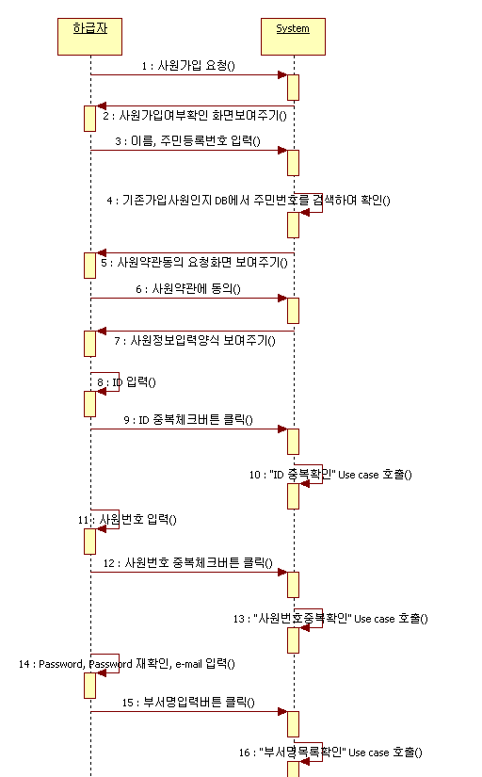
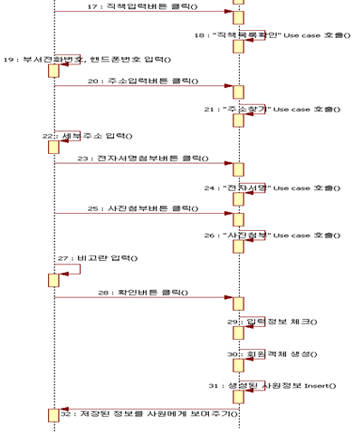
Activity 2035. Refine System Sequence Diagram

Slide 7
Activity 2037. Define State Diagrams

Slide 8
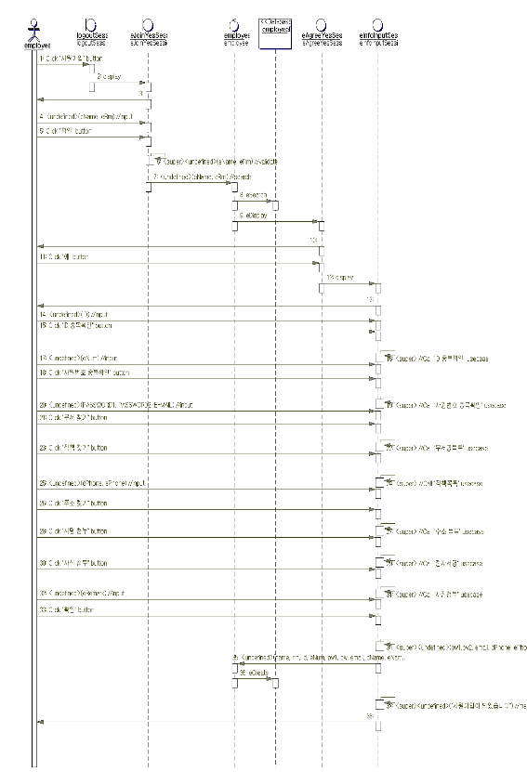
Activity 2044. Define Interaction Diagram

Slide 9
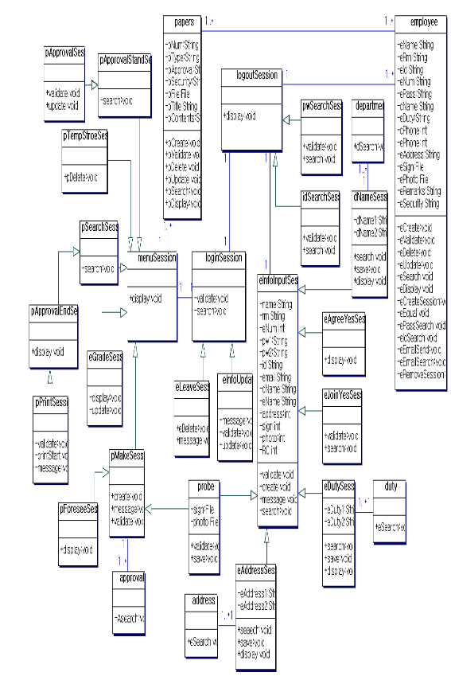
Activity 2045. Define Design Class Diagram

Slide 10
Coding
#ifndef PAPERS_H
#define PAPERS_H
class menuSession;
class employee;
class papers {
public:
void pCreate();
void pValidate();
void pDelete();
void pUpdate();
void pSearch();
void pDisplay();
private:
String pNum;
String pType;
String pApproval;
String pSecurity;
File pFile;
String pTitle;
Sting pContents;
/**
* @clientCardinality 1..*
* @supplierCardinality 1..*
*/
employee * lnkemployee;
/**
* @clientCardinality 1..*
* @supplierCardinality 1
*/
menuSession * lnkmenuSession;
};
#endif //PAPERS_H

Slide 11
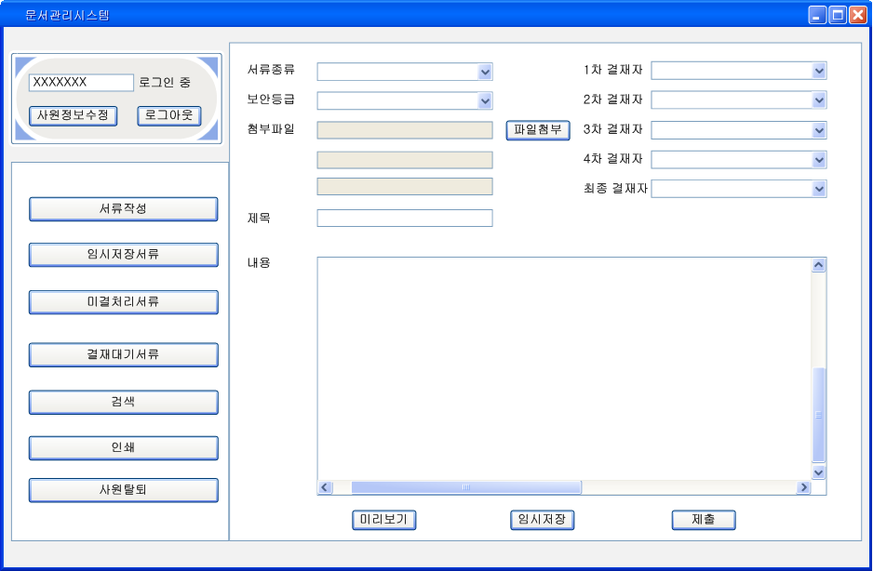
Realization

Slide 12
Thank you

